Slide 1
Predicting Log Likelihood Ratios With Machine Learning
By: Jonathan Nguyen
Ucla id: 304929013

Slide 2
Generating the Data
Data was generated using MATLAB
Use pre-defined “constellation maps” to map randomly generated source bits to a symbol
Each constellation map was constructed with an average symbol energy of 1
Also note that each constellation map was constructed in ascending bit order
constellation_map(1) corresponds to 0000, constellation_map(2) corresponds to 0001
Add complex AWGN noise to each entry of our symbol vector
Calculate Log-Likelihood Ratio of each bit
Export the Data as a .csv file to be fed into Python

Slide 3
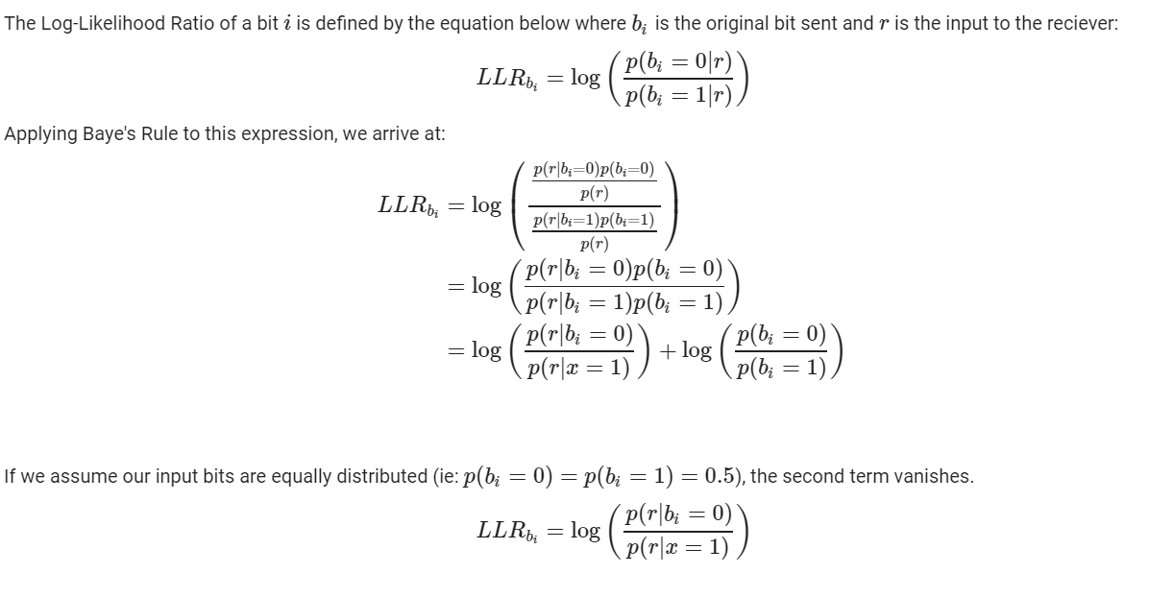
Calculating LLRs

Slide 4
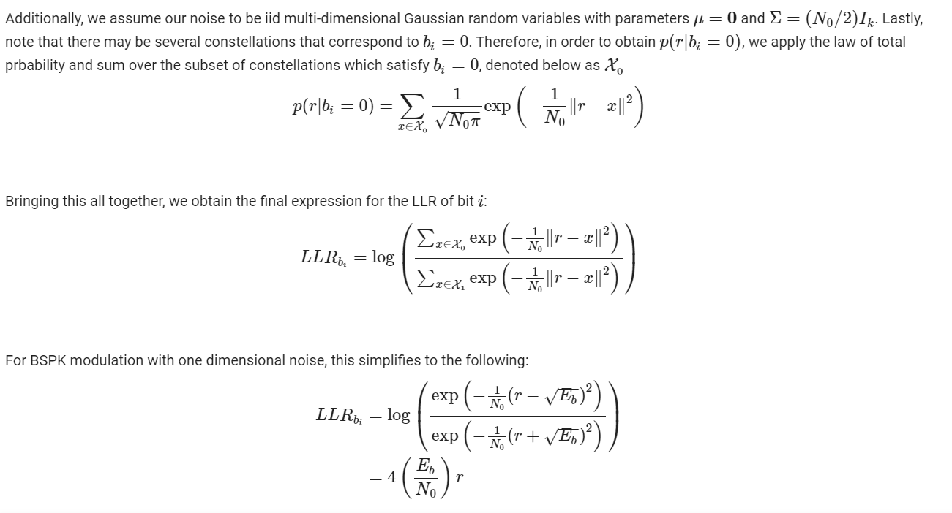
Calculating LLRs (Cont.)

Slide 5
Calculating LLRs: The Algorithm
Store sum of exp() terms corresponding to ith bit = 0 in a variable called num_sum
Do the same for ith bit = 1 with a variable called dem_sum
Loop through constellation map, swap whether looking at 0 or 1 every 2^(i-1) iterations
Apply log ( num_sum / dem_sum) to get LLR
Bit 3 | Bit 2 | Bit 1 | Index in Constellation map
0 | 0 | 0 | 1
0 | 0 | 1 | 2
0 | 1 | 0 | 3
0 | 1 | 1 | 4
1 | 0 | 0 | 5
1 | 0 | 1 | 6
1 | 1 | 0 | 7
1 | 1 | 1 | 8

Slide 6
Additional Features
Can generate symbols / LLRs over a range of SNRs
Can generate symbols / LLRs for a single SNR with fading
Fading attenuation follows Rayleigh distribution and phase shift is uniform distributed over [0, 2π]

Slide 7
Neural Network Model Overview
Utilized Keras Library to construct a fully connected MIMO network
Each input to the network corresponds to the in-phase and quadrature component of our symbol respectively
Each output corresponds to the predicted LLR of each bit
For BPSK, there is 1 output, QPSK has 2 outputs, …, 16_QAM has 4 outputs
Network contains 6-7 hidden layers which progressively smaller layer sizes
The hidden layers are shared between all outputs
Output of hidden layers are fed into several layers that are each unique to each bit

Slide 8
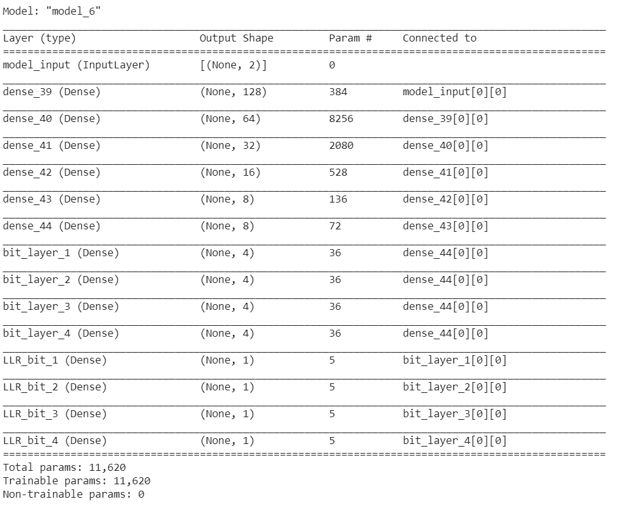
Example Model Summary

Slide 9
Selecting Hyperparameters
The metric was chosen as Mean Squared Error (MSE)
Reason: We are working with soft outputs, Therefore, we want to minimize the distance between the predicted LLR and the actual LLR
Loss function was chosen to be logcosh:
Reason: For small differences, logcosh behaves similarly to mean squared error (x^2 / 2). For larger differences, it behaves closer to abs(x) - log(2) which is more linear. This has the effect of not penalizing wildly incorrect predictions as heavily which may skew the model towards overfitting those points.
ReLU was chosen for the activation function empirically
Reason: Through running several tests, it was shown to result in the lowest MSE and training time. This is backed up by other papers.

Slide 10
Dropout and Batch Normalization
I did not use Batch Normalization in my model because it resulted in worse training and validation accuracy.
Perhaps if I ran my model for more epochs, this issue may have gone away.
The purpose of bathnorm is to ensure that the input to each layer has the same statistics (mean and variance).
This is a form of regularization which can help the model train faster and prevent overfitting.
Dropout did not help when training, so I did not use it in any model except for the fading channel.
In fact, for dropout rates 0.1, 0.2, and 0.5, the performance of the models trained on a single SNR and an SNR range degraded.
Even on the fading channel, the improvement was marginal
Dropout prevents overfitting by only giving the model access to a subset of the data at a time
This can be viewed as an approximate form of bagging

Slide 11
Results (16 QAM trained on 1.8 dB data)

Slide 12
Results (16 QAM trained on 1.8 dB data)

Slide 13
Results (16 QAM trained on [0,10] dB data)

Slide 14
Results (16 QAM trained on 1.8 dB data with fading)

Slide 15
Implementation with Channel Coding
I had previously written code to simulate Frame Error Rates (FER) when decoding LDPC codes given their parity check matrix.
Simulation assumes all zeros codeword was sent
However the code was written in C++ as opposed to Python or MATLAB
Used library to import pre-trained model from Python into C++
Decoder was implemented using full-precision belief propagation (message passing) and with a relatively short block length code
802.11n with rate=0.5 and n=1296

Slide 16
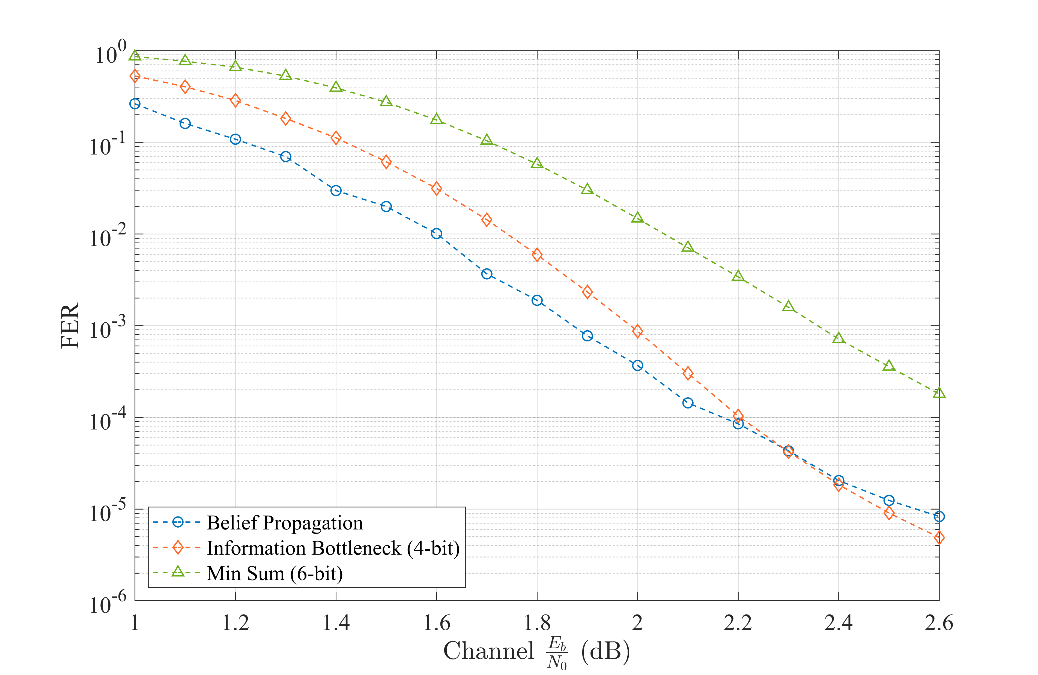
Results

Slide 17
Results (8 QAM trained on 1.8 dB data)

Slide 18
Results (8 QAM trained on [0,10] dB data)

Slide 19
Results (8 QAM trained on 1.8 dB data with fading)

Slide 20
Results (8PSK trained on 1.8 dB data)

Slide 21
Results (8PSK trained on [0,10] dB data)

Slide 22
Results (8PSK trained on 1.8 dB data with fading)

Slide 23
Results (QPSK trained on 1.8 dB data)

Slide 24
Results (QPSK trained on [0,10] dB data)

Slide 25
Results (QPSK trained on 1.8 dB data with fading)

Slide 26
Results (BPSK trained on 1.8 dB data)

Slide 27
Results (BPSK trained on [0,10] dB data)

Slide 28
Results (BPSK trained on 1.8 dB data with fading)

